Slide 1
Advanced Programming
Assignment Two(MVC Project )

Slide 2

Advanced Programming(MVC Project)
Introduction
FEGHS Solution
Topic of Choice: Film Review Website
Deliverables:
Modelling
Maintaining GitHub Repo
Designing (Walkthrough)
Issues/Limitations
Conclusion

Slide 3
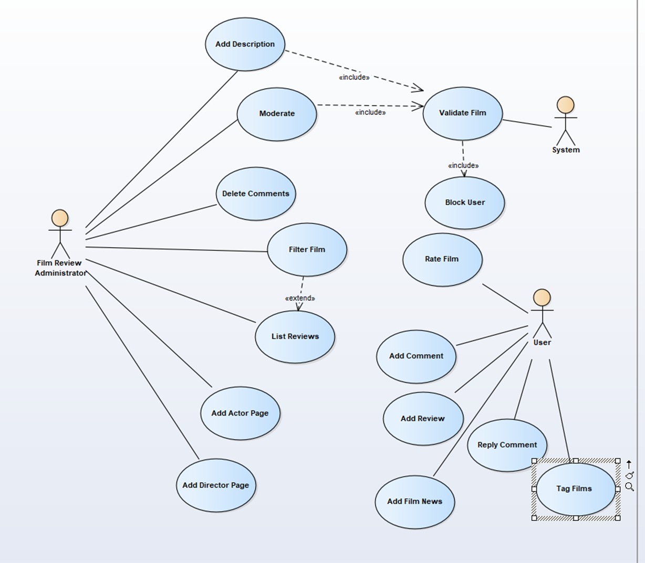
Advanced Programming(MVC Project)
USE CASE DIAGRAM
Purpose
System Requirements
Identify Actors In a System

Slide 4
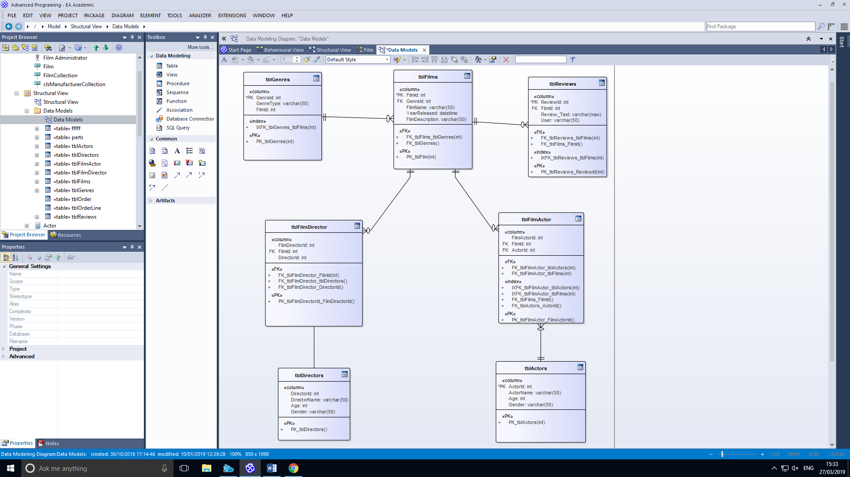
Advanced Programming(MVC Project)
Entity Relationship Diagram
Purpose
Helps Identify Entity and Relationships within those entities
Identify Primary and Foreign Keys
Conceptual model of a database

Slide 5
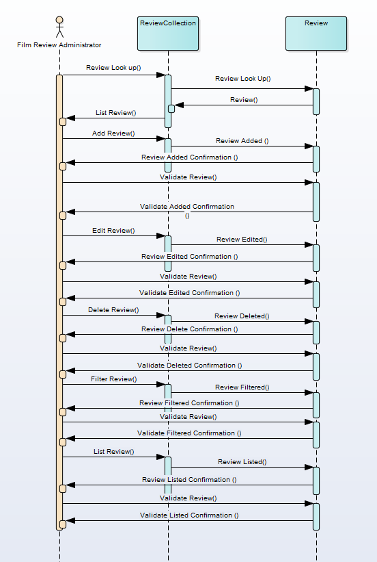
Advanced Programming(MVC Project)
PURPOSE
Show object interactions arranged in time sequence

Slide 6
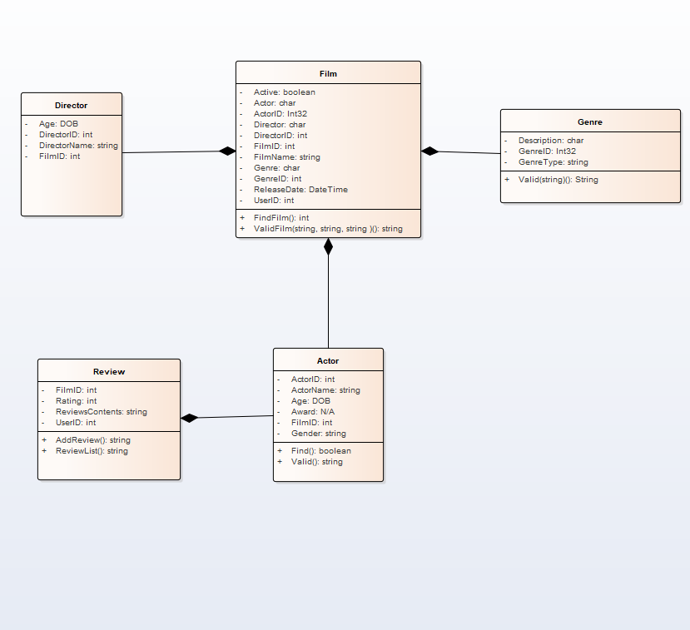
Advanced Programming(MVC Project)
PURPOSE
Model static view of an application

Slide 7
Advanced Programming(MVC Project)
Maintaining GitHub Repo

Slide 8
Advanced Programming(MVC Project)
Designing (Walkthrough)

Slide 9
Advanced Programming(MVC Project)
Issues/Limitations
Bootstrap Implementation – Time Management/Lack of Skills
Database? Was It Needed?
Added Functionality:
- Filter Film
- Search Film

Slide 10
Advanced Programming(MVC Project)
Conclusion
Fully Completed Modelling
Fully Functioning MVC Project
Excellent Team Work

